Slide 1
Module 5 Wireless Network Security
Security in GSM; UMTS Security; Bluetooth Security; WEP; WPA2.
Self-learning Topics :- Study of Wireless Security Tools.

Slide 2
Security in GSM
Security is implemented to prevent unauthorized use of the mobile subscriber number over the air.
The voice conversations need to encrypted using secrecy algorithm in GSM.
Authentication is done with the help of a pre- defined protocol that is used to compare IMSI of MS reliably.
A unique secret key (128 bits) is stored in SIM card.
It uses 3 algorithms
1. A3 – for Authentication (verify users password within SIM)
A5 – for confidentiality (it scramble coded data)
A8 – generate privacy key that used to encrypt voice or data messages.

Slide 3
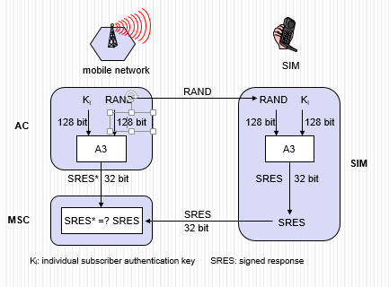
GSM - authentication
Ki is the 128-bit Individual Subscriber Authentication Key utilized as a secret key shared between the Mobile Station and the Home Location Register of the subscriber’s home network.
RAND is 128-bit random challenge generated by the Home Location Register.
SRES is the 32-bit Signed Response generated by the Mobile Station and the Mobile Services Switching Center.

Slide 4
The GSM network authenticates the identity of the subscriber through the use of a challenge-response mechanism.
Step 1: A 128-bit Random Number (RAND) is sent to the MS. The MS computes the 32-bit Signed Response (SRES) based on the encryption of the RAND with the authentication algorithm (A3) using the individual subscriber authentication key (Ki).
Step 2:Upon receiving the SRES from the subscriber, the GSM network repeats the calculation to verify the identity of the subscriber.

Slide 5
The individual subscriber authentication key (Ki) is never transmitted over the radio channel, as it is present in the subscriber's SIM, as well as the AUC, HLR, and VLR databases.
If the received SRES agrees with the calculated value, the MS has been successfully authenticated and may continue.
If the values do not match, the connection is terminated and an authentication failure is indicated to the MS.
The calculation of the signed response is processed within the SIM. It provides enhanced security, as confidential subscriber information such as the IMSI or the individual subscriber authentication key (Ki) is never released from the SIM during the authentication process.

Slide 6
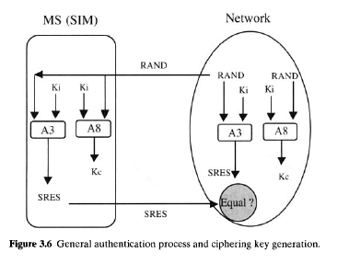
Signalling and Data Confidentiality
Kc is the 64-bit ciphering key used as a Session Key for encryption of the over-the-air channel.
Kc is generated by the Mobile Station from the random challenge presented by the GSM network and the Ki from the SIM utilizing the A8 algorithm.

Slide 7
The SIM contains the ciphering key generating algorithm (A8) that is used to produce the 64-bit ciphering key (Kc).
This key is computed by applying the same random number (RAND) used in the authentication process to ciphering key generating algorithm (A8) with the individual subscriber authentication key (Ki).
GSM provides an additional level of security by having a way to change the ciphering key, making the system more resistant to eavesdropping.
The ciphering key may be changed at regular intervals as required. As in case of the authentication process, the computation of the ciphering key (Kc) takes place internally within the SIM.
Therefore, sensitive information such as the individual subscriber authentication key (Ki) is never revealed by the SIM.

Slide 8
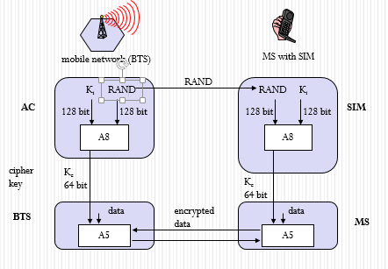
GSM - key generation and encryption

Slide 9
Encrypted voice and data communications between the MS and the network is accomplished by using the ciphering algorithm A5.
Encrypted communication is initiated by a ciphering mode request command from the GSM network. Upon receipt of this command, the mobile station begins encryption and decryption of data using the ciphering algorithm (A5) and the ciphering key (Kc).

Slide 10
Subscriber Identity Confidentiality
To ensure subscriber identity confidentiality, the Temporary Mobile Subscriber Identity (TMSI) is used.
Once the authentication and encryption procedures are done, the TMSI is sent to the mobile station.
After the receipt, the mobile station responds.
The TMSI is valid in the location area in which it was issued. For communications outside the location area, the Location Area Identification (LAI) is necessary in addition to the TMSI.

Slide 11
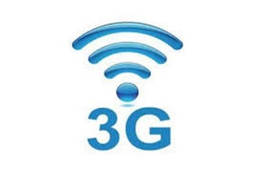
UMTS Security Procedure
UMTS Authentication and Key Agreement (AKA) is a security mechanism used to accomplish the authentication features.
It is based on a challenge/response authentication protocol which is used for a MS to verify the identity of another mobile subscriber without revealing a secret password shared by the two.
The key concept is that each mobile subscriber must prove to the other that it knows the password without actually revealing or transmitting such a password.

Slide 12
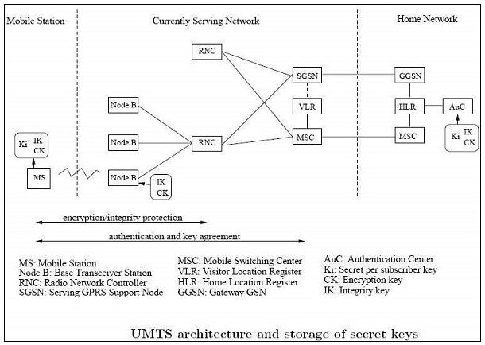

Slide 13
Steps of Authentication and Key Agreement procedure:
Step 1: Visited network's VLR/SGSN requests a set of AVs [authentication vectors] from the HLR/AuC in the mobile subscriber's home network.
Step 2. HLR/AuC computes an array of AVs. This is done by means of the 'authentication algorithms and the mobile subscriber's private secret key K, which is stored only in the home network's HLR/ AuC and the user Identity Module (USIM) in the mobile subscriber's mobile subscriber.
Step 3. Home network's HLR/ AuC responds by sending n authentication vectors back to the visited network's VLR/SGSN.
Step 4. Visited network's VLR/SGSN chooses one AV and challenges the mobile subscriber's USIM by sending the RAND and AUTN fields in the vector to it.
Step 5. The mobile subscriber's USIM processes the AUTN.

Slide 14
Steps of Authentication and Key Agreement procedure: (cont)
With the aid of the private secret key K, the mobile subscriber is able to verify that the received challenge data could only have been constructed by someone who had access to the same secret key K.
The USIM will also verify that the AV has not expired by checking its Sequence Number (SEQ) field
Provided that the network can be authenticated and that the AV is still valid, the USIM proceeds to generate a Confidentiality Key (CK), an Integrity Key (IK) and a Response for the network (RES).
Step 6. The mobile subscriber responds with RES to the visited network.
Step 7. Visited network's VLR/SGSN verifies that response is correct by comparing the Expected Response (XRES) from the current AV with the Response (RES) received from the mobile subscriber's USIM

Slide 15
UMTS Subscriber to UMTS Network
Both the network and the mobile station supports all the security mechanisms of UMTS.
Authentication and Key agreement is as follows −
The MSand the BS establish a radio resource control connection (RRC connection).
During the establishment of the connection the MS sends its security capabilities to the BS. Security features include UMTS integrity and encryption algorithms supported and possibly GSM encryption capabilities as well.
The MS sends its temporary identity TMSI current on the network.
If the network cannot solve the TMSI, he asks the MS to send its permanent identity and the mobile stations responding to the request with the IMSI.

Slide 16
The visited network requests authentication of the home network of the mobile station data.
The home network returns a random challenge RAND, the corresponding authentication token AUTN, authentication
Response XRES, integrity key IK and the encryption key CK.
The visited network sends RAND authentication challenge and authentication token AUTN to the mobile Station.
The MS checks AUTN and calculates the authentication response.
If AUTN is corrected. The mobile station sends its authentication response RES to the visited network. Else Mobile station ignores the message.

Slide 17
Visiting network checks if RES = XRES and decide which security algorithms radio subsystem is allowed to use.
The visited network sends algorithms admitted to the radio subsystem.
The radio access network decides permit (s) algorithms to use.
The radio access network informs the mobile station of their choice in the security mode command message.
The message also includes the network security features received from the mobile station in step 1.
This message is integrity protected with the integrity key IK.
The mobile station confirms the protection of the integrity and verify the accuracy of the safety functions.

Slide 18
UMTS Subscriber to GSM Base Station
The mobile unit (subscriber UMTS) supports both USIM and SIM application.
The base station system uses GSM while the VLR / MSC technology components are respectively the UMTS SGSN.
The mobile station and the core network both support all security mechanisms of UMTS.
However, the base station system GSM (BSS) does not support the protection of the integrity and uses the GSM encryption algorithms.
The first eight steps of the authentication protocol are performed as in the classical case. GSM BSS simply forwards the UMTS authentication traffic.

Slide 19
The MSC / SGSN decides which GSM encryption algorithms are allowed and calculates the key GSM Kc UMTS keys IK, CK.
The MSC / SGSN advises the GSM BSS authorized algorithms and transmits the GSM cipher key Kc.
GSM BSS decide which encryption algorithms allowed to use based encryption capabilities of the mobile station.
GSM BSS sends the GSM cipher mode command to the station.

Slide 20

Bluetooth Security

Slide 21
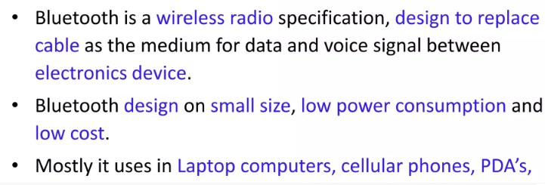
Introduction

Slide 22
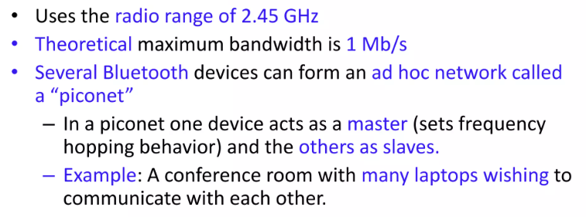
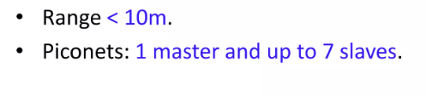

Slide 23
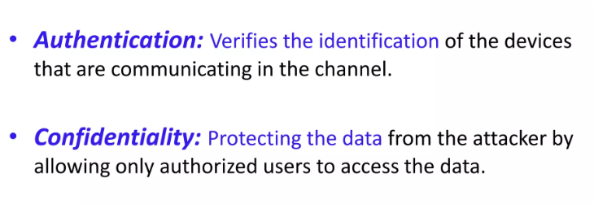
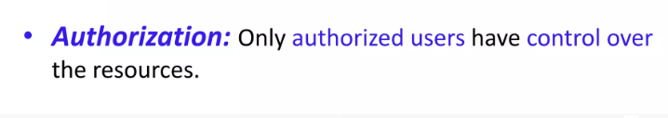
Bluetooth Security

Slide 24
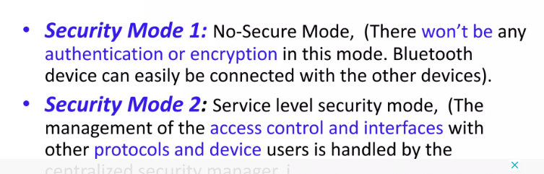
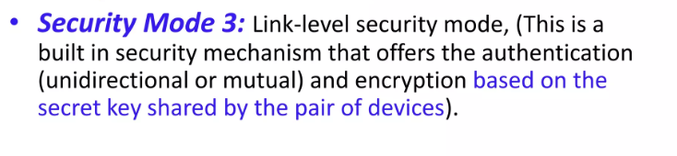
Security mode of bluetooth

Slide 25
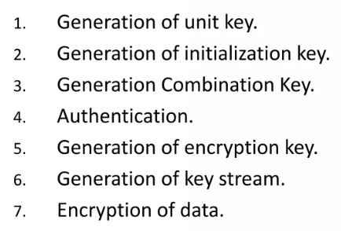
Protocols in Bluetooth

Slide 26
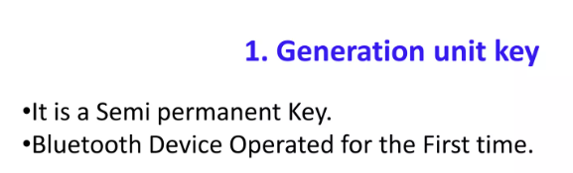
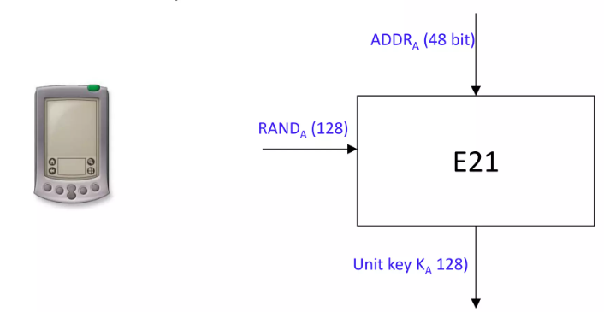

Slide 27


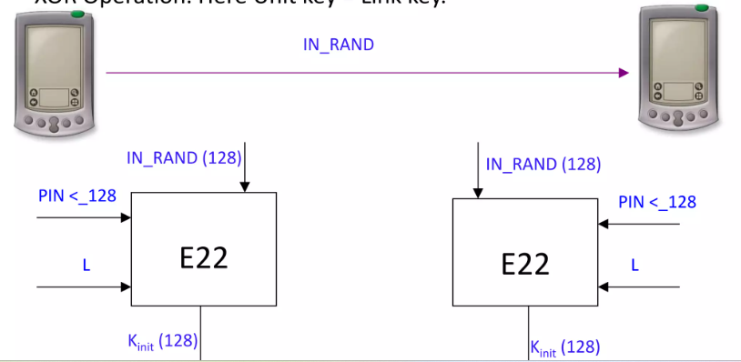

Slide 28
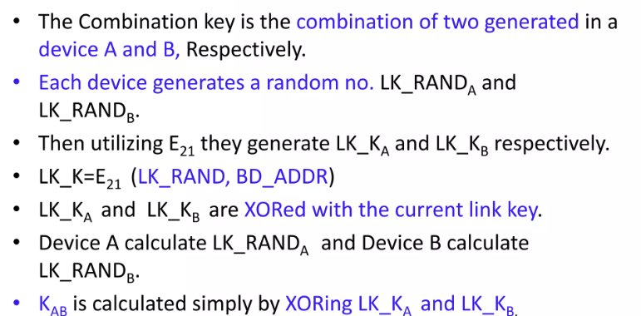
Generation Combination key

Slide 29
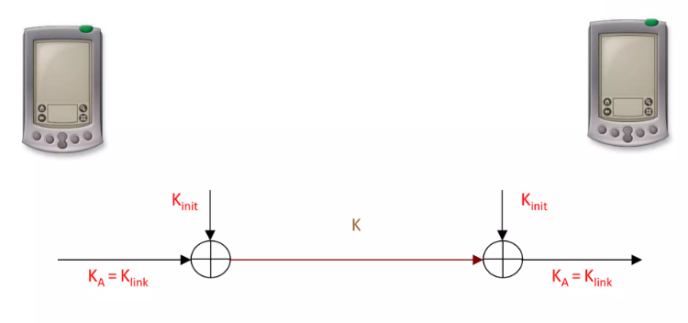

Slide 30
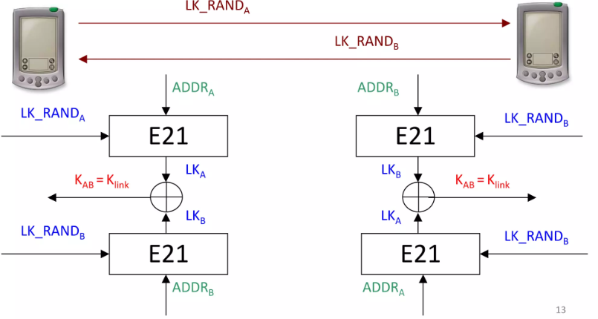

Slide 31
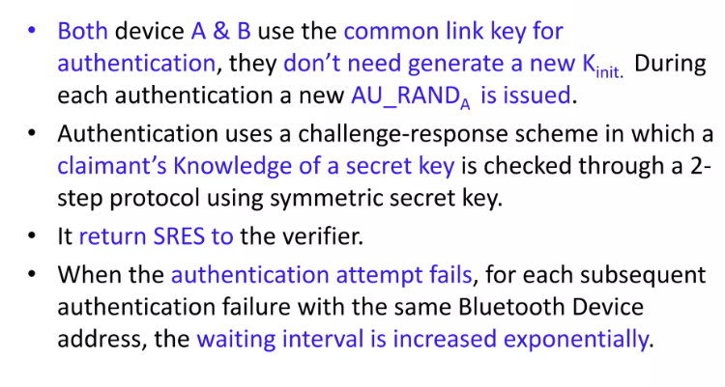
Authentication

Slide 32
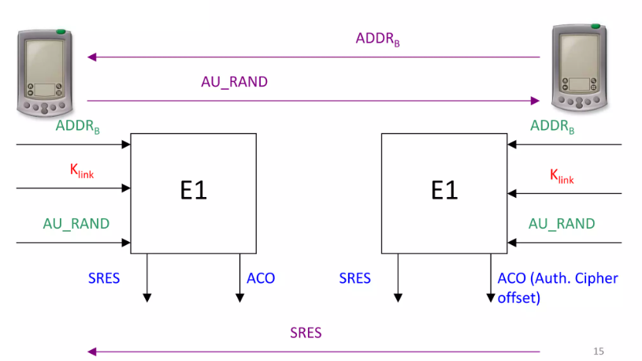

Slide 33
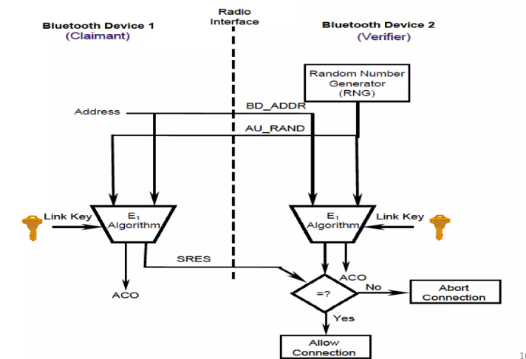

Slide 34
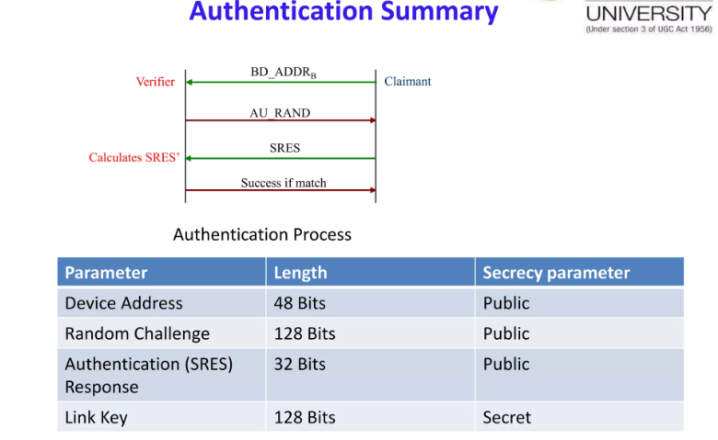

Slide 35
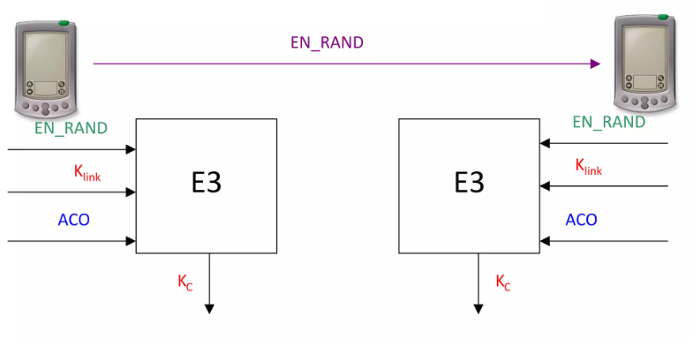
Generation of encryption key

Slide 36
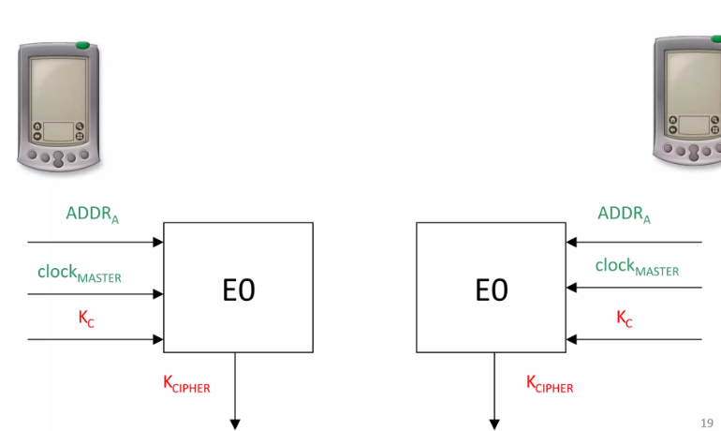
Generation key stream

Slide 37
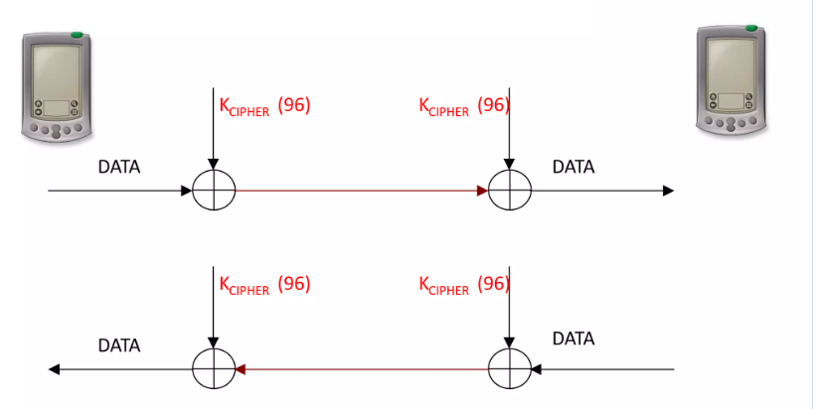
7. Encryption of data

Slide 38
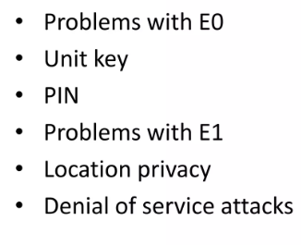
Security weakness

Slide 39
Summary
Bluetooth technology allows for replacing many proprietary cables that connect one device to another with one universal short range radio link.
Bluetooth radio technology provides a universal bridge to existing data networks, a peripheral interface, and a mechanism to form small, private ad hoc groupings of connected devices away from fixed network infrastructures.

Slide 40
The Bluetooth technology has a number of advantages including minimal hardware dimensions, low cost of components, and low power consumption.
These advantages make it possible to introduce Bluetooth in many types of devices at a low cost.
The 720 kbps data capability provided by Bluetooth can be used for cable replacement and several other applications, such as LAN.

